Slide 1
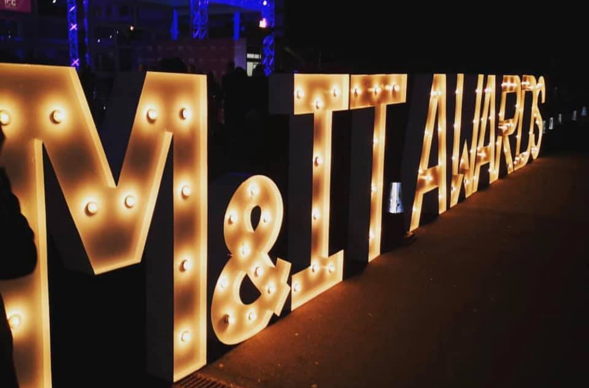
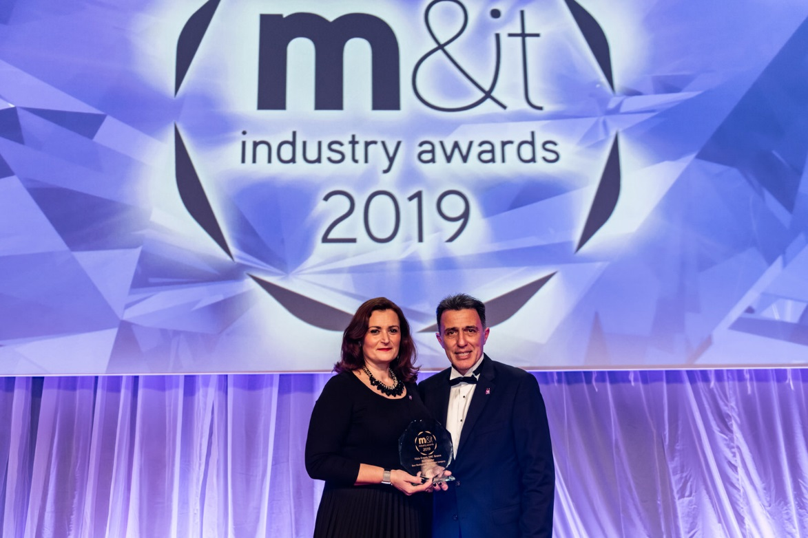
Vista Events DMC
Gold Award Winner!
The Meetings & Incentive Travel Industry Awards 2019 was a special event for Vista Events DMC.
Held on Friday 1st of March at Battersea Evolution in London, biggest and most prestigious ceremony of the event industry, the M&IT Awards, known as the Oscars of the meetings industry, distinguished Vista Events during the gala presentation dinner that saw record numbers in attendance.
The event showcases companies that have excelled and contributed by offering excellent handling services to the industry, including hotels, airlines, convention centers and destination management companies.
Vista Events Greece won the Gold Award in “Best Destination Management Company” (Best DMC) category.
Panos Fragakis, Managing Director and Rena Gkini, Director of Sales & Marketing were there to receive the award.
“We are exuberant and moved! This one special! It is the lucky 13th for us! The thirteen in a row award we are winning and we feel really honored! An M&IT Award is always such a fantastic recognition for us! A great honor for our company and our team, especially as clients within the industry are voting for it. On behalf of everyone at Vista Events, we would like to thank our clients for unremitting their trust. This distinction fuels our passion” said Gkini.

